Slide 1
HOUSING : PRICE PREDICTION MODEL

Slide 2
PROBLEM DEFENITION
The client aims at investing in real estate in Australia
Information is required on the factors affecting prices of houses in the region
Models are required that predicts accurately the prices of houses if invested by the client.

Slide 3
DATA CLEANING AND PREPROCESSING
Null and eronious data was treated and adjusted
No data ( columns / rows ) were removed for the scope of the project.
Plots were done to get the insights about the data
The object type data was encoded and converted to numeric format

Slide 4
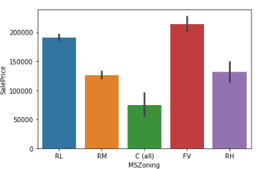
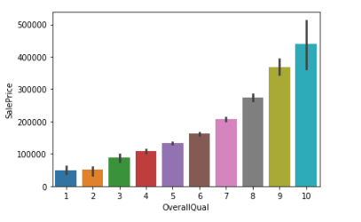
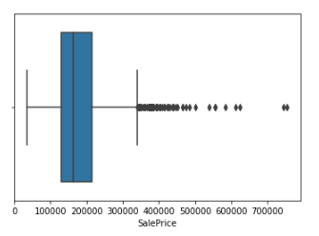
Visualizations
Plots with label and other attributes were plotted to find trends in the data.
Box plots were also generated to test for outliers, and they were detected.

Slide 5
Modelling
A Typical regression problem where the output is the price of the house.
Linear regression, Lasso regression and Lightgbm were implemented and the scores were as :
Linear Regression – 92.8
Lasso Regression – 94.17
LightGBM - 92.8

Slide 6
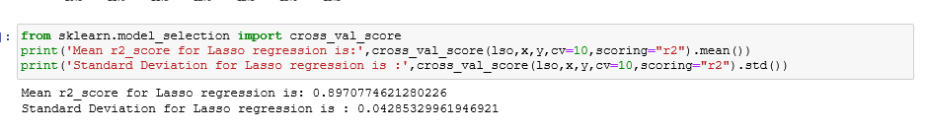
Modelling and Metrics
Out of the results, Lasso Classifier is estimated to be the best performing model and hence we proceed further evaluating other metrics

Slide 7
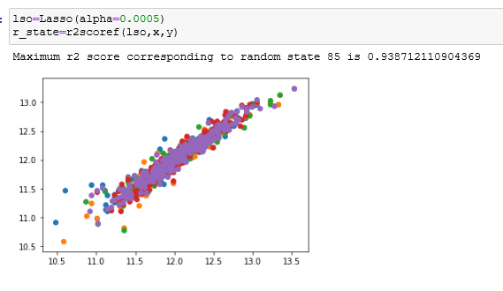
Hyperparameter Tuning
Checking if Lasso regression can be further enhanced using GridSearchCV.

Slide 8
Model Selection and Conclusion
Lasso has all the metric scores > 90% and is considered a very good model.
The model can be deployed for future use and prediction
Deep Learning model was also implemented on the same data set and the performance was satisfactory.

